Slide 1
‘Blast Droids’ Gameplay and System Analysis
Dashboard Team: Cole Astaire, Ramzi Mourtada, Uddipon Das
Data Team: Ryan Booth, Ilio Benvenuti
CS399-F19 Project 7

Slide 2
Project 6
Concept
Data
Dashboard

Slide 3
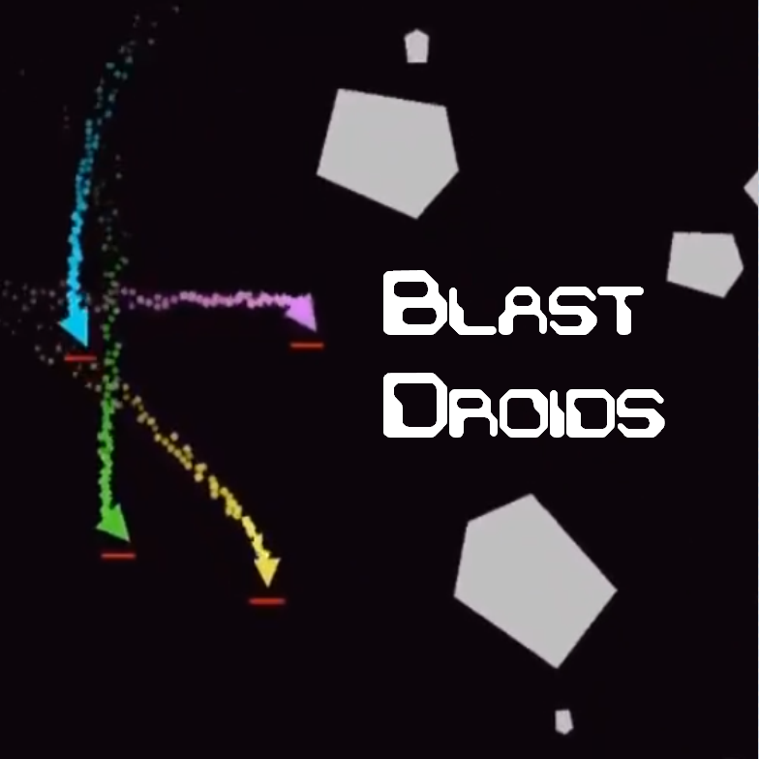

Slide 4
System Performance Analysis
Explore the difference in performance over game progression.
Dynamic

Slide 5
System Performance Analysis
Graphics
Physics
Entities
AI
Input
Sound

Slide 6
Level 1

Slide 7
Level 7

Slide 8
Level 15

Slide 9
Level 50

Slide 10
Level 100

Slide 11
Gameplay Analysis
Visualize basic unit test data for evaluating gameplay balance.
Dynamic

Slide 12
Unit Test

Slide 13
Project 6
Concept
Data
Dashboard

Slide 14
The LOGR
Event-based local log pipeline.
static LogTypeData logTable[LOG_TYPE_MAX] =
{
{"L_string", &LogString},
{"L_contact", &LogContact},
{"L_shot", &LogShot},
{"L_spawn", &LogSpawn},
{"L_death", &LogDeath},
{"L_damage", &LogDamage},
{"L_transform", &LogTransform},
{"L_time", &LogTime},
{"L_StatePush", &LogStatePush},
{"L_StatePop", &LogStatePop},
{"L_system_time", &LogSystemTime}
};

Slide 15
The LOGR
Manages file stream.
void Log_LogData(LOG_TYPE logType, LogDataGeneric genericLogData, void *excessData)
{
if (logFile != NULL)
{
fprintf_s(logFile, "%f,", Time_Get()->sinceStateStart);
fprintf_s(logFile, "%s,", genericLogData.sourceFile);
fprintf_s(logFile, "%s,", logTable[logType].name);
(*logTable[logType].function)(excessData);
fprintf_s(logFile, "\n");
}
}

Slide 16
Data Format – System Performance
0.216317, Engine.c, L_time, 18.224918, 0.216317,0.016729, 1.000000
0.216317, Engine.c, L_system_time, AI, 0.001834
0.216317, Engine.c, L_system_time, Input, 0.000151
0.216317, Engine.c, L_system_time, Sound, 0.000005
0.216317, Engine.c, L_system_time, Physics, 0.001874
0.216317, Engine.c, L_system_time, Entities, 0.001849
0.216317, Engine.c, L_system_time, AE_Graphics, 0.009570
0.232983, Engine.c, L_time, 18.241585, 0.232983, 0.016665, 1.000000
0.232983, Engine.c, L_system_time, AI, 0.001793
0.232983, Engine.c, L_system_time, Input, 0.000146
0.232983, Engine.c, L_system_time, Sound, 0.000005
0.232983, Engine.c, L_system_time, Physics, 0.001803
0.232983, Engine.c, L_system_time, Entities, 0.001791
0.232983, Engine.c, L_system_time, AE_Graphics, 0.009918

Slide 17
Data Format – Gameplay
26.125044,HealthComponent.c,L_death,EnemySimple,55,L_TeamEnemy,1553.33,4621.42,,,,
26.125044,ShotLogData.c,L_damage,(null),0,L_TeamEnemy,0,2.470875,EnemySimple,103,1970.400391,4545.592773
26.125044,HealthComponent.c,L_death,EnemySimple,103,L_TeamEnemy,1970.4,4545.59,,,,
26.125044,ShotLogData.c,L_damage,(null),0,L_TeamEnemy,0,3.536487,EnemySimple,61,1747.28064,4586.897461
26.125044,HealthComponent.c,L_death,EnemySimple,61,L_TeamEnemy,1747.28,4586.9,,,,
26.125044,ShotLogData.c,L_damage,(null),0,L_TeamEnemy,0,3.707935,EnemySimple,95,1923.926147,4664.442383
26.125044,ShotLogData.c,L_damage,(null),0,L_TeamEnemy,0,2.934891,EnemySimple,81,2042.730103,4728.420898
26.125044,HealthComponent.c,L_death,EnemySimple,81,L_TeamEnemy,2042.73,4728.42,,,,
26.125044,ShotLogData.c,L_damage,(null),0,L_TeamEnemy,0,1.891892,EnemySimple,179,2232.238037,4809.823242
26.125044,ShotLogData.c,L_damage,(null),0,L_TeamEnemy,0,2.435628,EnemySimple,189,1789.046997,5209.350098

Slide 18
Project 6
Concept
Data
Dashboard

Slide 19
Demo

Slide 20
Questions/Comments

